Slide 1
Online Bouquet Store
EP SKILL PROJECT

Slide 2
About Our Project
Our project is about online bouquet store in which users can order and customize bouquets of their choice.
We have divided bouquets into categories based on the occasions and displayed them according to the occasions.
Users can customize their own bouquets according to their taste.
We named our application as Blossom Flowers.

Slide 3
Modules
We identified 5 modules in our project
1.Login and Register Module In login module user enters his/her username and password if both are valid browser redirects to login page. In register module user enters email address username phone number and password and gets registered.
2.User Module In user module all kinds of flowers are displayed divided into different categories home page about page are also included in this user module.
3.Product Browsing Module In product browsing module user can search for products he wants to order and search for specific kind of products.

Slide 4
4.Check Out Module In checkout module user can customize a personalized message for his/her order and user can also customize a personalized flower bouquet if needed.
5.Payment Module In payment module user enters his/her card details and pays amount.

Slide 5
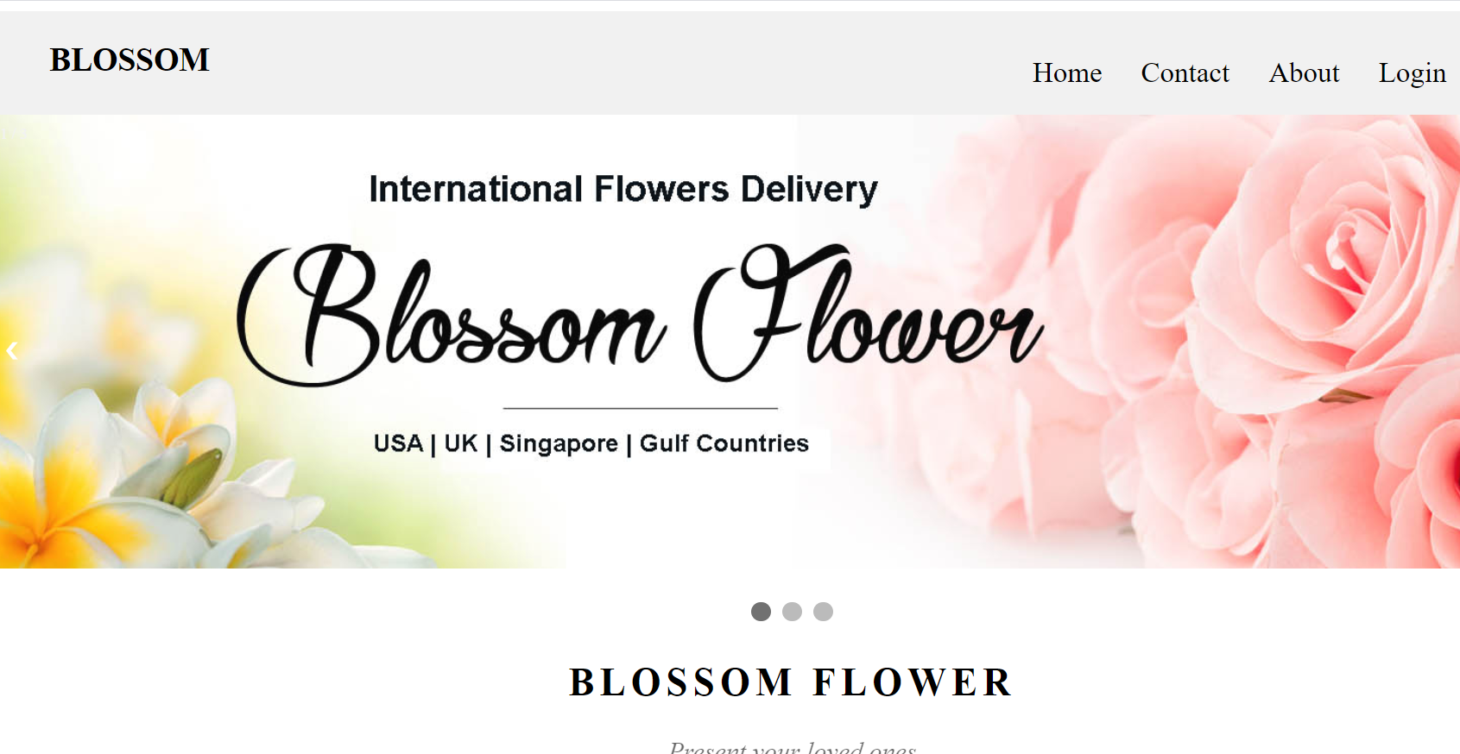

Slide 6
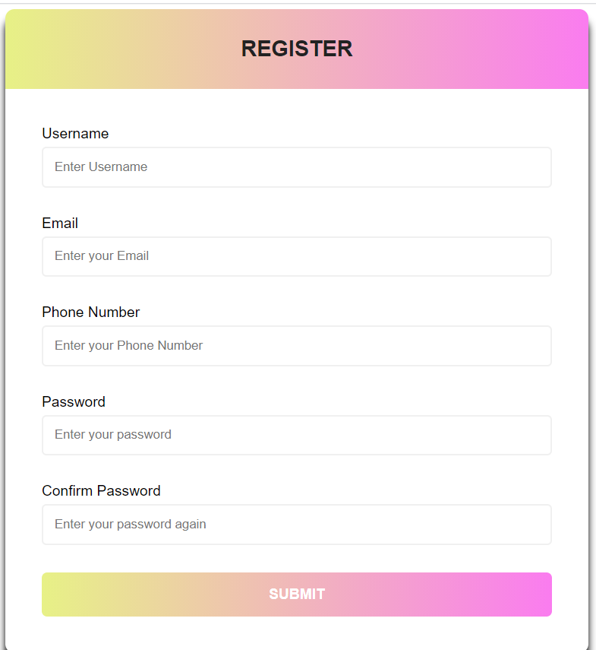
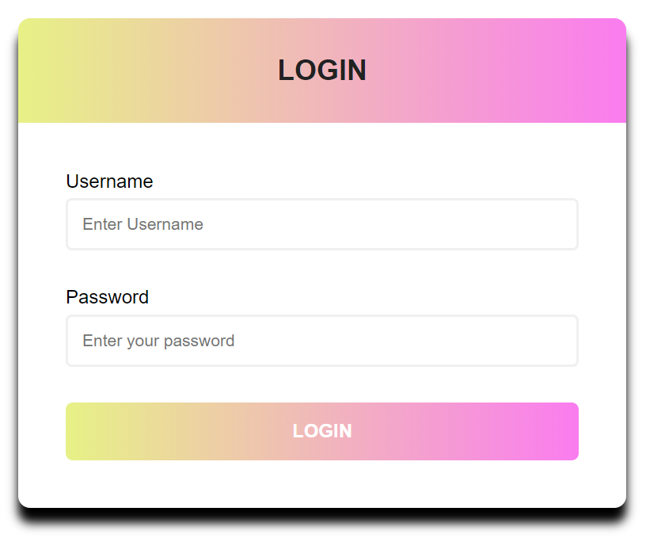

Slide 7
